Slide 1
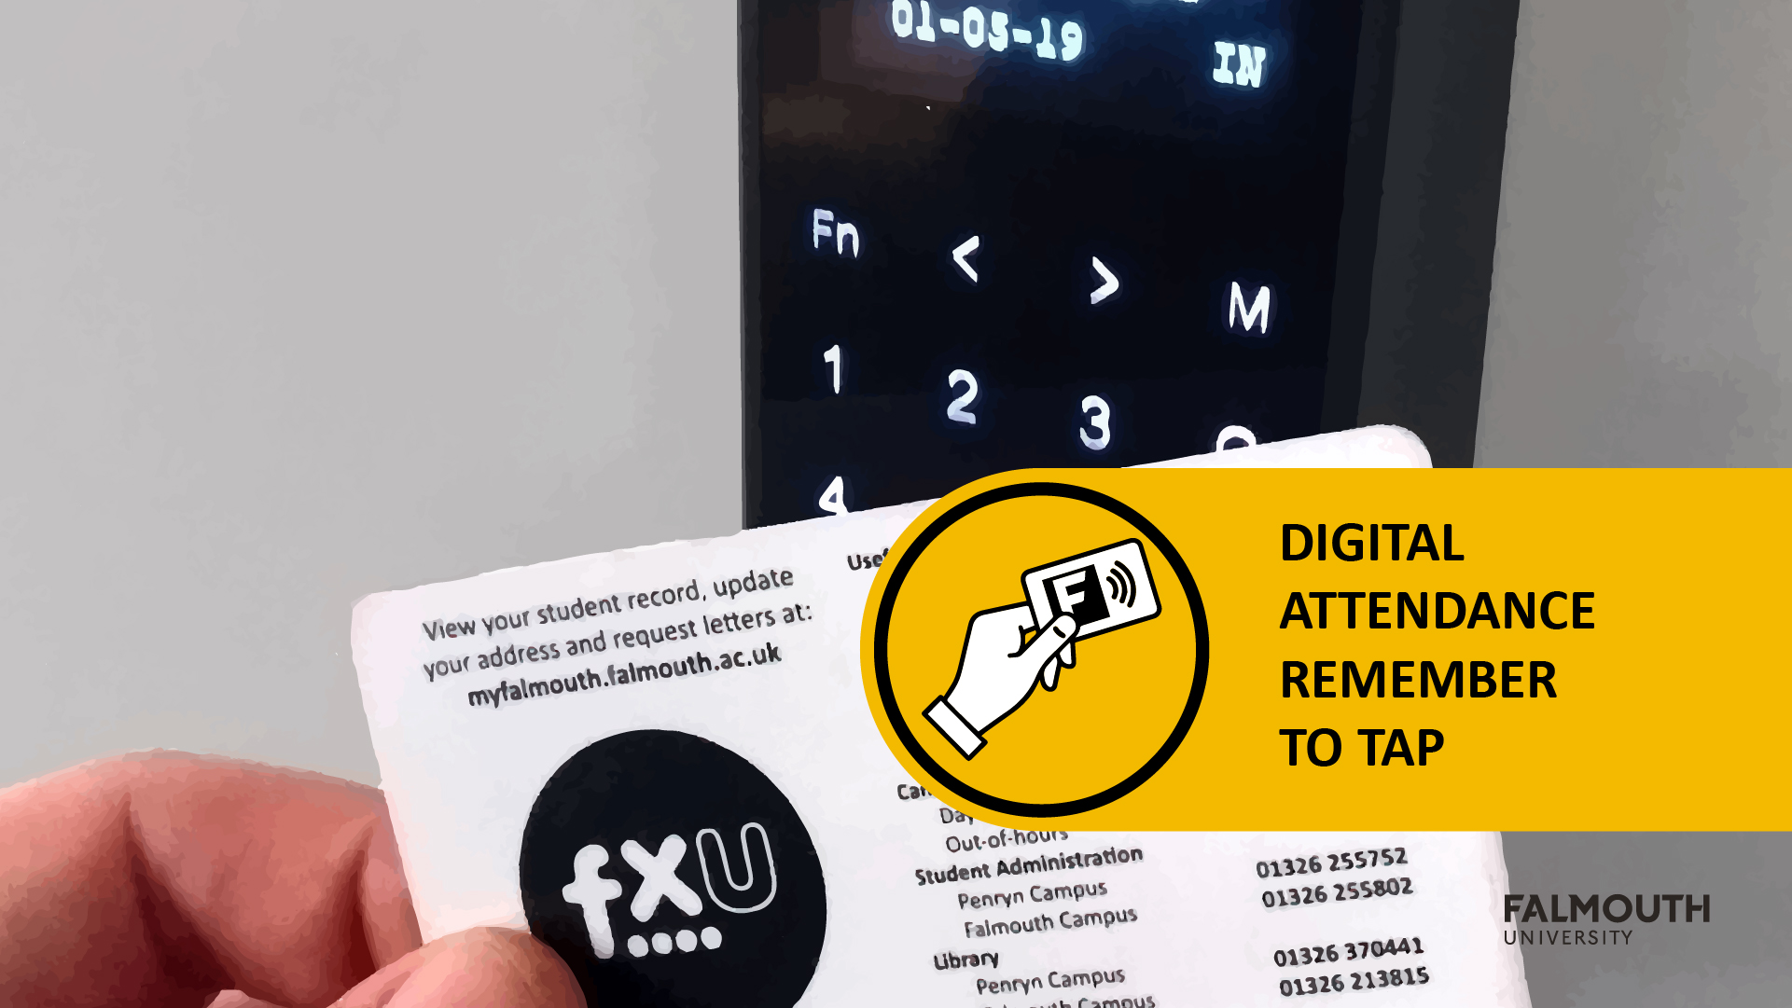

Slide 2



Slide 3
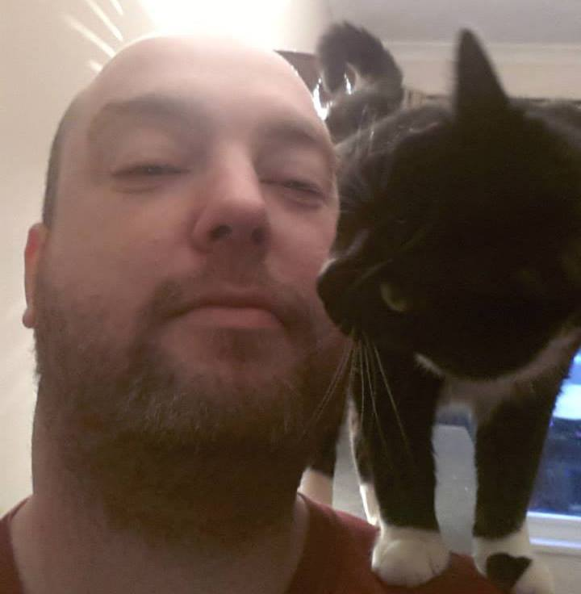
Brian McDonald
- Programming and Development
Brian is a keen advocate for the Games Development Community. He was elected to serve on the board of IGDA Scotland from 2013 - 2016. In this role he helped bring together the Game Developers from around Scotland by organising monthly meetings and developer talks.
brian.mcdonald@falmouth.ac.uk

Slide 4
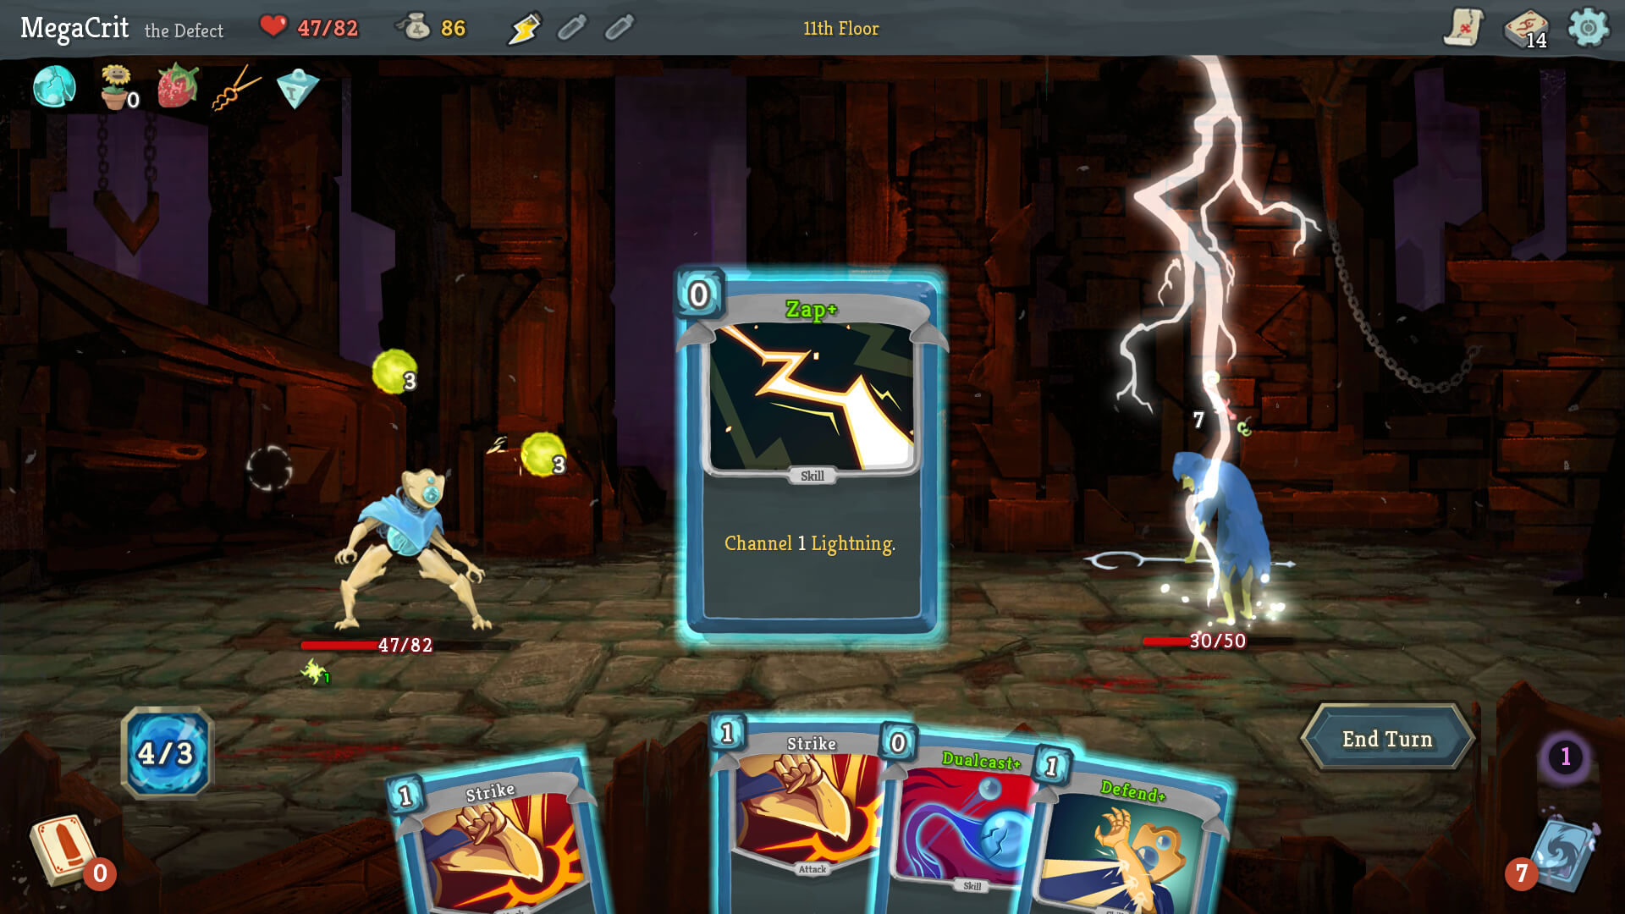

Slide 5

Module
Aims
https://learningspace.falmouth.ac.uk/course/view.php?id=3962
Please check the award maps for more details on this structure

Slide 6
Module AIMS
To deliver an engaging experience based on an original virtual ‘world’ through professional development and enterprise.

Slide 7
More Broadly
work in a multi-skilled team and continue work on the ‘world creation’ project that you started during the previous study block
The module will focus on delivering content in line with production milestones and the processes involved in preparing to take your product to market
With formative feedback from your tutors, you build your product using Agile and iterative method
Tutors will provide advice on the commercial potential of your concept. By the end of the module your product should be at a stage where it could be released as a commercial endeavour

Slide 8
Learning Outcomes
ID | NAME | DESCRIPTION | ASSESSMENT CRITERIA CATEGORY
6 | Reflect | Analyse your strengths and weaknesses in relation to knowledge, skills, experience, and outcomes associated with your professional attributes. | ANALYSIS
7 | Collaborate | Use appropriate development practices, project tracking approaches, and tools to support development pipelines in a multidisciplinary team. | COLLABORATION
9 | Deliver | Apply divergent thinking and creativity to prototyping in order to deliver an engaging experience. | INNOVATION

Slide 9
Assignments
Please check learning space for full details
https://learningspace.falmouth.ac.uk/course/view.php?id=3962

Slide 10
Assignment
Assignment 1 – Studio Practice – 70%
Assignment 2 – Evaluation – 30%
Check MyFalmouth for Deadlines - https://myfalmouth.falmouth.ac.uk/

Slide 11
Assignment 1 – Studio Practice
Supervisor meetings
Attend the scheduled weekly team meeting with your project supervisor.
There are two types of project meeting:
A project review / planning session - Your team will showcase work undertaken on the most recent sprint and then plan the next sprint
An individual review - You and your teammates will review each other’s approaches to work over the last sprint

Slide 12
Assignment 1 – Studio Practice
Studio Practice
You will work as a team in timetabled sessions
There will be members of staff on hand to lend support
Please ask for specialist support in these sessions
Staff will be assigned to assess your game
Expo
Held during Week 13
More about this soon!

Slide 13
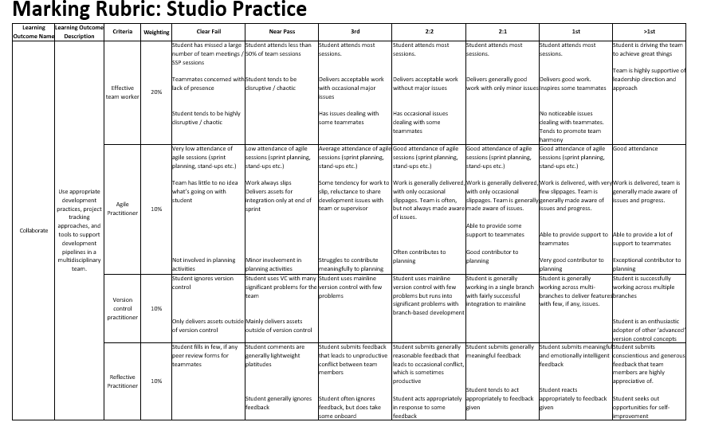
Assignment 1 – marking Rubric

Slide 14
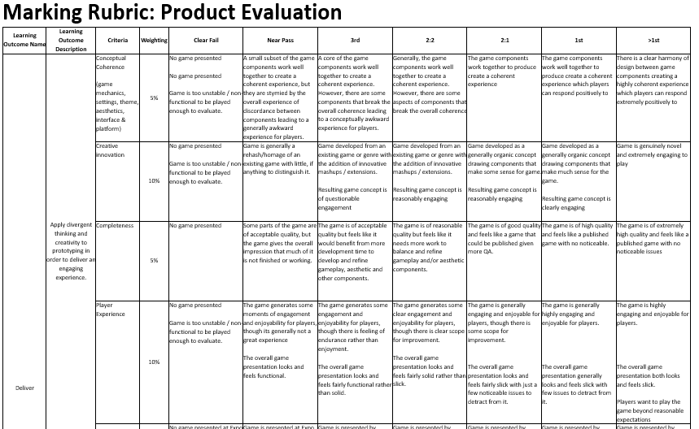
Assignment 1 – marking Rubric

Slide 15
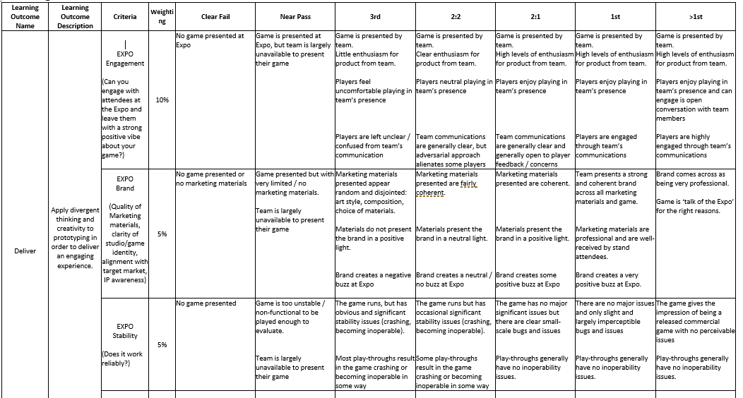
Assignment 1 – marking Rubric

Slide 16
Studio Practice – things to note
Supervisor meetings are assessed and you will be marked on each sprint
You should always turn up with a working build
you can also show off artwork and works in progress
Marks for sprints will be normalised at the end of EXPO

Slide 17
Assignment 2 – EVALUATION
you will write a 1000-word evaluation of your work on your game development so far
You will reflect on:
Progress on the development of the game
How it is going
Your contribution to it
Think forward to what you would do differently next year
You should create a list of actions for next year, these should be SMART in nature

Slide 18
Assignment 2 – EVALUATION
you will ALSO WRITE a 1000-word Market Evaluation
Which addresses the following points:
Demonstrate an understanding of the audience/market
What is unique about your game
How your specialism will help to deliver the game
Evidence an understanding of your place in the games sector and your value to the project
Provide a plan of how to get the game to market
You will receive support for this in the Business LectureS

Slide 19
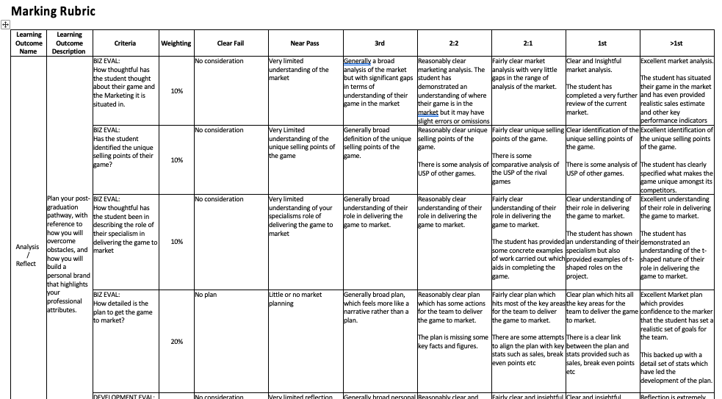
Assignment 2 – Marking Rubric

Slide 20
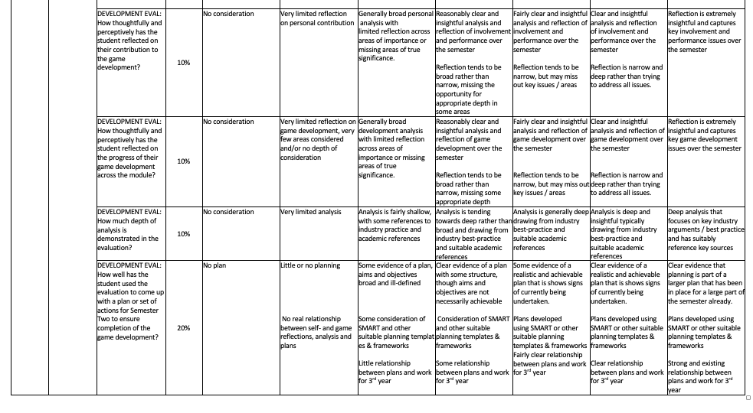
Assignment 2 – Marking Rubric

Slide 21
Assignment 2 – Development Evaluation
Evaluations are an extremely important part of the learning process and should not be taken lightly:
You must critically appraise both your work and your approach to and understanding of that work.
Do not write a narrative. Pick 3-5 points you consider to be important and explore these in depth critically and reflectively.
As you work on your projects, make a note of interesting points that the evaluation may discuss
Include a plan or set of actions that will help you to complete the development in3rd year. These should arise from your evaluation.

Slide 22
Agile
Practice
https://learningspace.falmouth.ac.uk/mod/resource/view.php?id=50269
Check out the Agile guide for more details

Slide 23
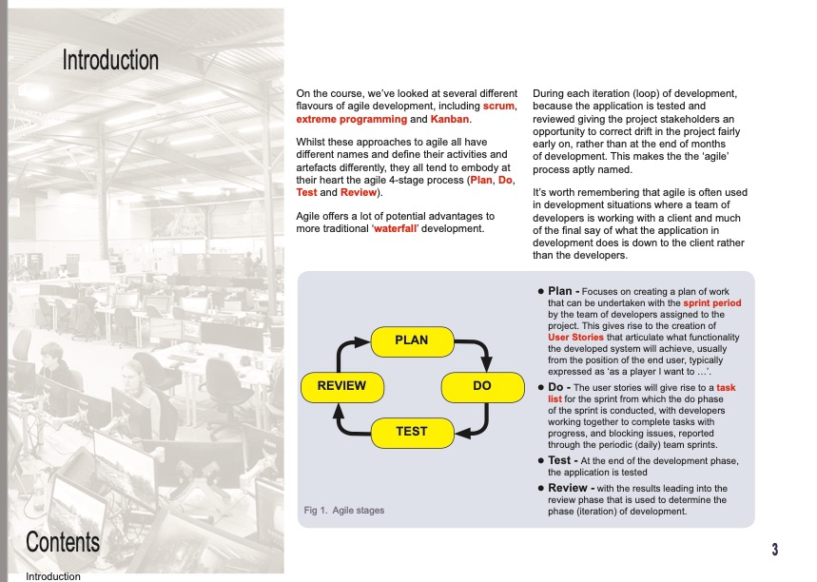
AGILE guide

Slide 24
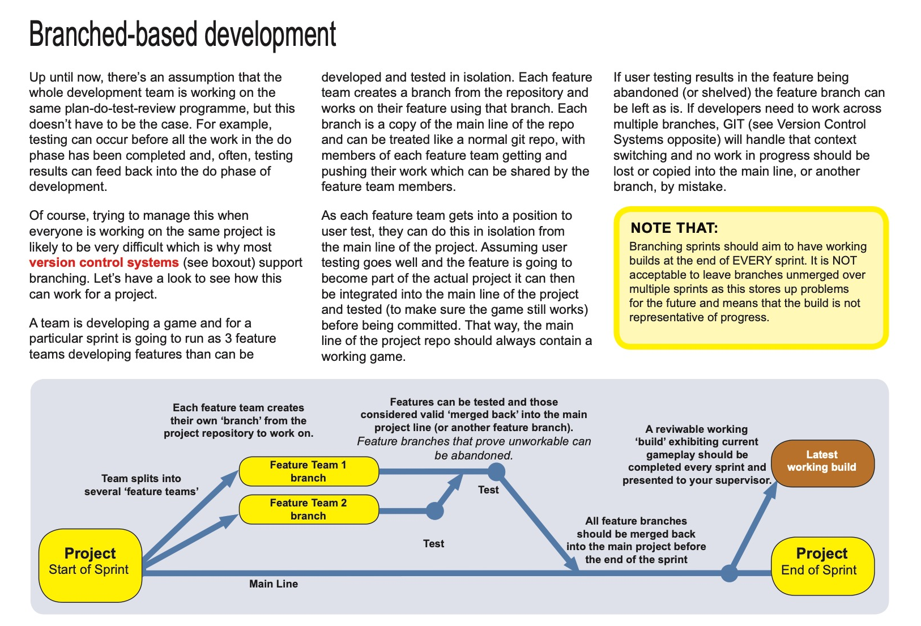
AGILE guide

Slide 25
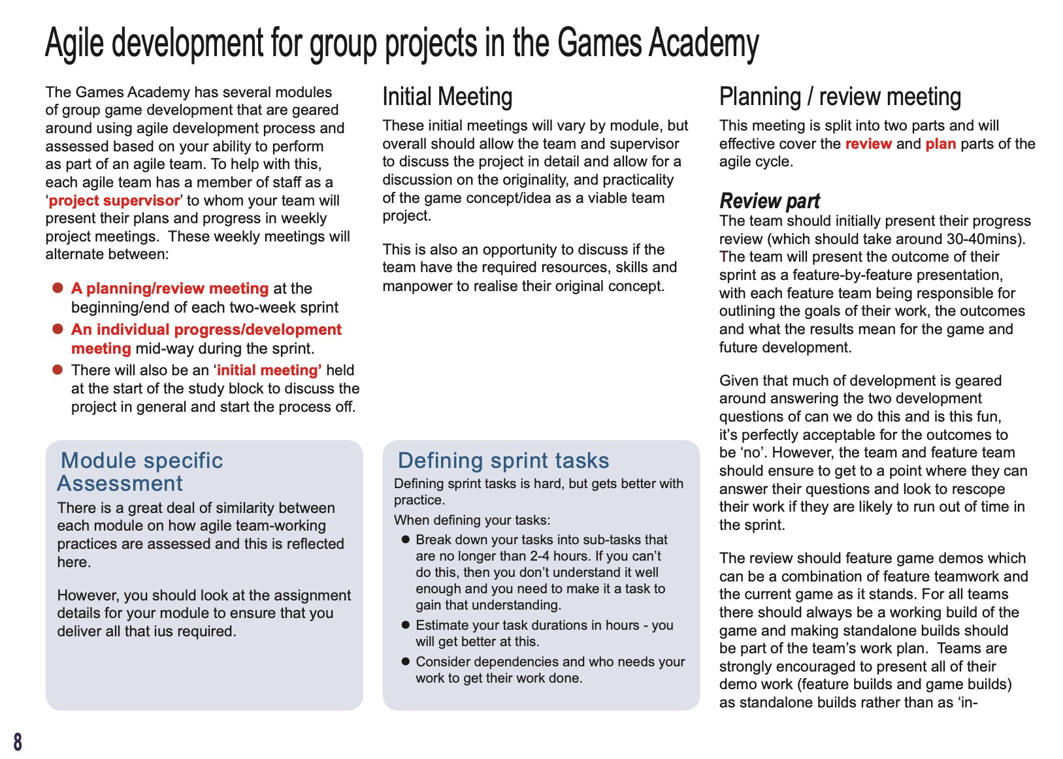
AGILE guide

Slide 26
Studio Culture

Slide 27
Studio Culture
At the games academy we do not tolerate harassment or bullying
We also adhere to the student code of conduct
https://www.falmouth.ac.uk/student-regulations
If there is any issues at all. please speak to a supervisor, module leader or personal tutor
Please be a supportive team member!

Slide 28
Questions?

